Slide 1

Math at Work - Ami Kang

Slide 2
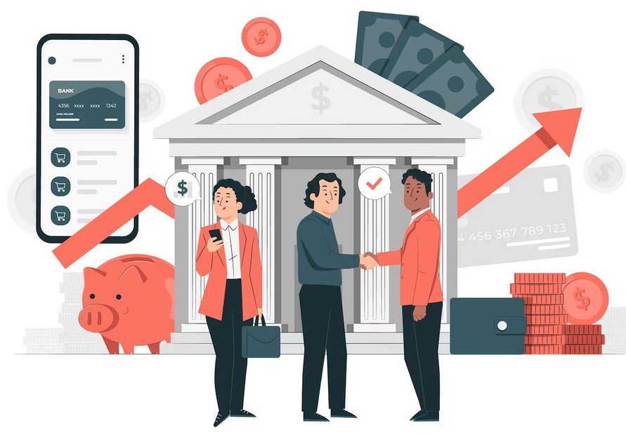
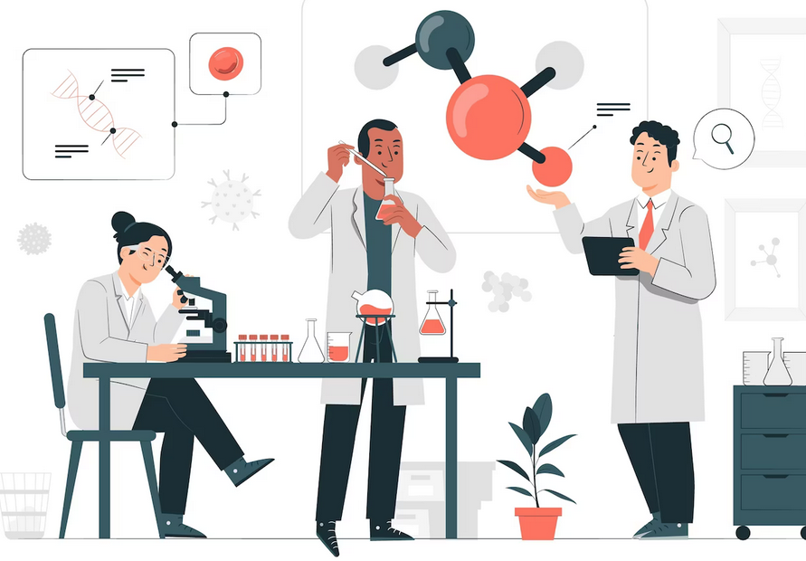
Experiments in a Bank?
+

Slide 3


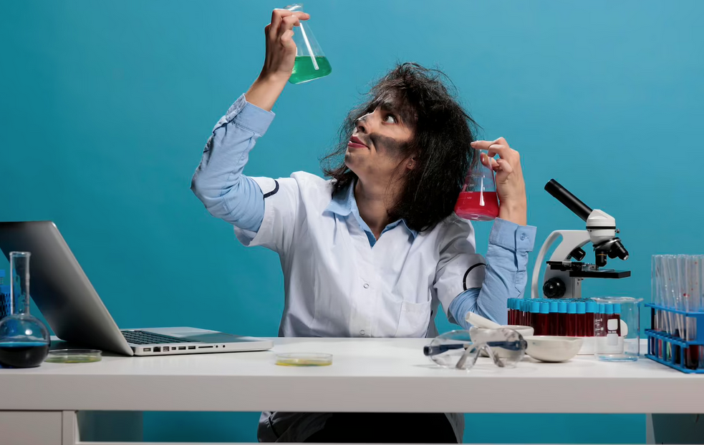
Experiments
What is it?
Why do you do that? .
test an idea or a method

Slide 4

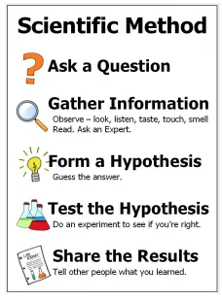

Source: https://inventorsoftomorrow.com/2018/08/18/scientific-method-songs/
: https://www.freepik.com/
Notes:
https://inventorsoftomorrow.com/2018/08/18/scientific-method-songs/

Slide 5
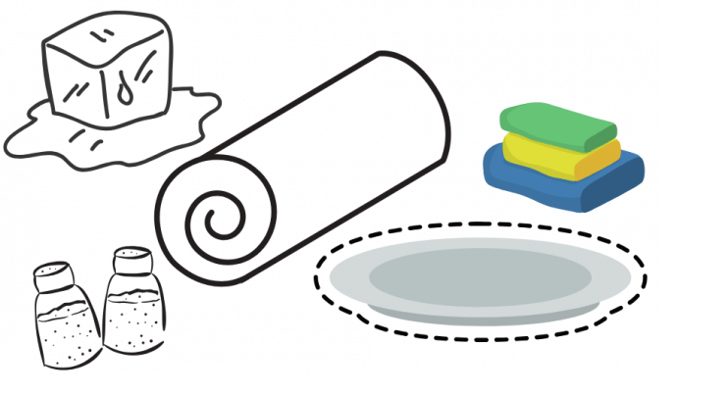
Observe
Question
Hypothesis/ Prediction
Experiment
Analyze/ Share learning
Ice melts fast in water.
Does ice melt faster in different liquids?
Ice will melt faster in juice than in water.
Ice cube in a glass of water
Ice cube in a glass of juice
Ice cube in an empty glass
How long does it take to melt a ice cube in each glass?
Source: https://littlebinsforlittlehands.com/using-scientific-method-experiments-kids/

Slide 6
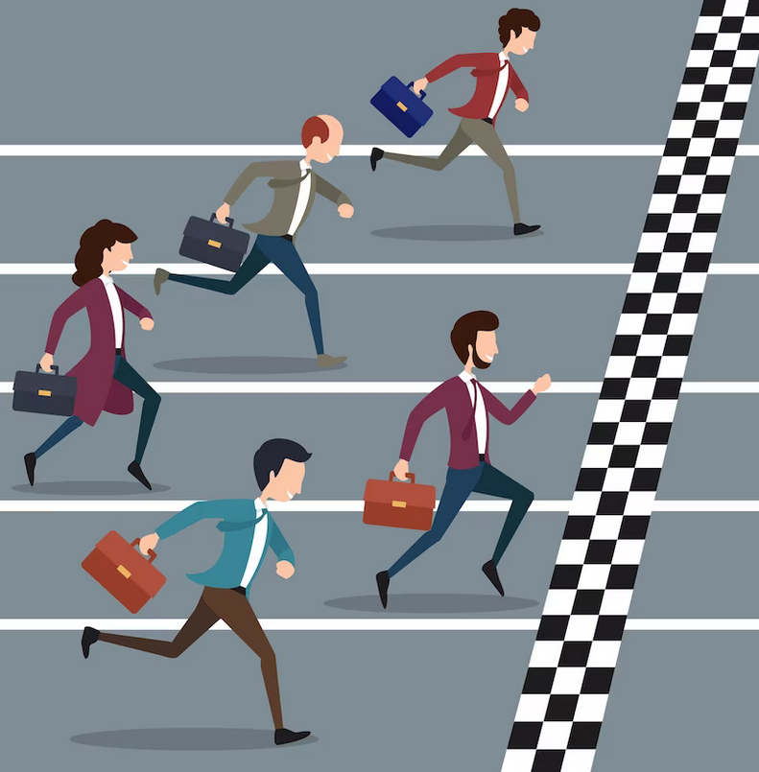
Banks
Q1. How many banks are in the US?
About 5,000 banks
Q2. What does it mean?
Competition, competition,
competition
Image Source: https://www.freepik.com/

Slide 7
Out of many things a bank does……
Let’s look at a few website experiment examples.
People do a lot of online banking.

Slide 8

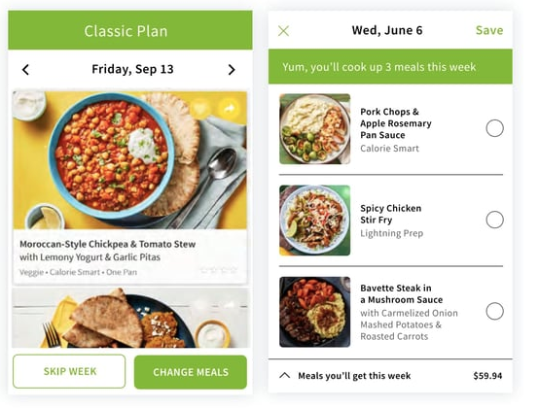
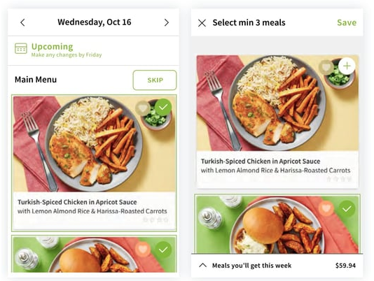
Which menu display is a winner?
(A) Menu Display
(B) Menu Display
contributed to a 7% increase in upselling revenue.
In general, people likes (B) website display more than (A) website display.

Slide 9
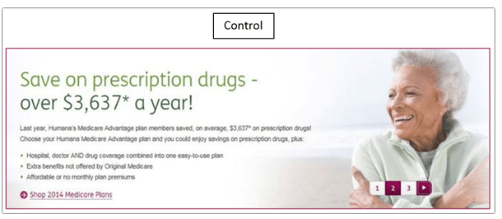
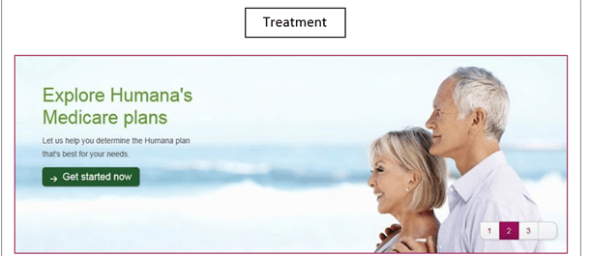

Advertisement 1
Which advertisement is a winner?
Advertisement 2
433% more click-throughs than the control.
Advertisement 3

Slide 10
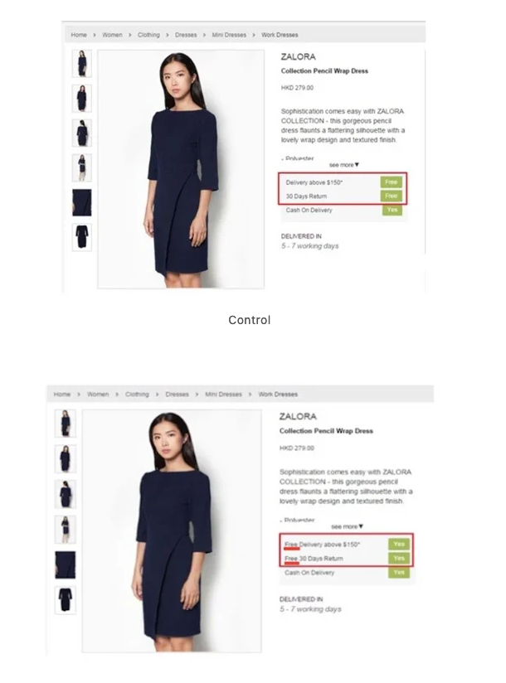
Which website design is a winner?
Website design <A>
Website design <B>
Zalora’s increased its checkout rate by 12.3% by optimizing its product pages
https://vwo.com/blog/ab-testing-examples/

Slide 11
Bank Website Marketing
Experiment

Slide 12
Question: How can we make people want to get more credit cards from the bank’s website?
Gather information: What kind of information is important to people?
Form a hypothesis: A new website design/contents will be more persuasive/appealing than the old website
Test the hypothesis: Run a website random test
Share the results: Analyze the difference between the old and new website performance and share the learning

Slide 13
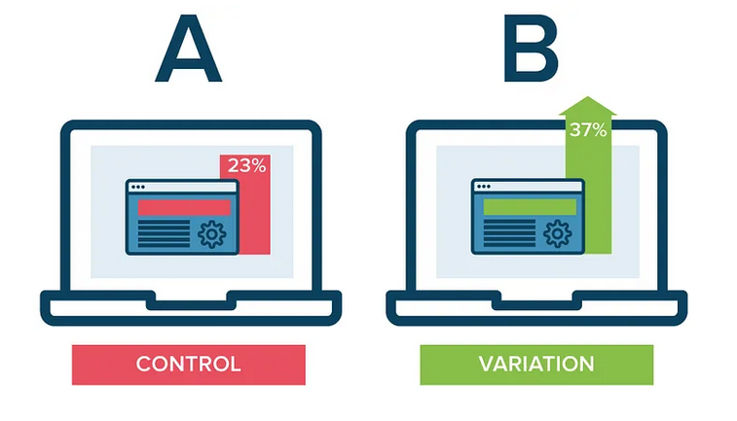
<Old>
<New>
Image source: https://medium.com/analytics-vidhya/a-b-testing-clearly-explained-56488430156

Slide 14
So… where is Math used???

Slide 15


So… where is Math used???

Slide 16
Before the Experiment/Test
After the Experiment/Test
Calculate minimum sample size
How confident/sure can we be about the test results?
ex) 23% is really different from 37%?
Can we ask all the people in the world to check the bank website?
Run Statistical Analysis
Compare averages
Compare %

Slide 17


These days..
Statistics
Modeling
Machine Learning
Artificial Intelligence
Image sources: https://www.freepik.com/

Slide 18

Thank you!
Any Questions or Comments?

